Slide 1
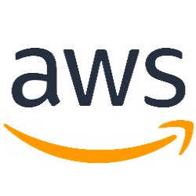
Amazon virtual private cloud (VPC) Topic: 3 Create by: MaiLT - Team 1 Date: 22/5/2019

Slide 2
This topic will cover to:
AWS VPC Overview
VPC Network component.
VPC and Subnets relationship.
Default VPC and Default Subnets
IP address.
Security
Scenarios and Examples

Slide 3
AWS VPC Overview

Slide 4

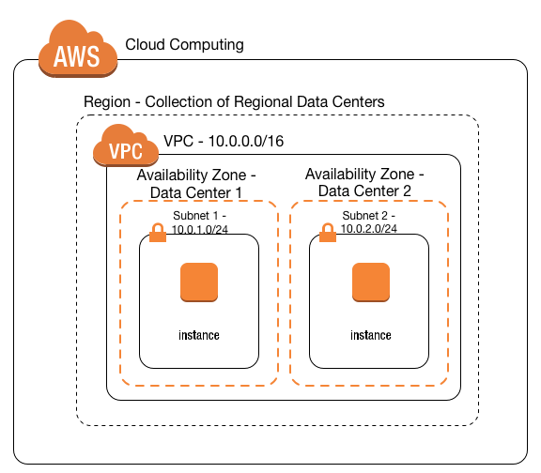
What is an Amazon Virtual private cloud (VPC)?
“A virtual network that closely resembles a traditional network that you’d operate in your own data center”

Slide 5
What is an Amazon Virtual private cloud (VPC)?
Amazon Virtual Private Cloud (Amazon VPC) enables you to launch Amazon Web Services (AWS) resources into a virtual network that you’ve defined. This virtual network closely resembles a traditional network that you’d operate in your own data center, with the benefits of using the scalable infrastructure of AWS.
You can launch your AWS resources, such as Amazon EC2 instances, into your VPC.
Your AWS resources are automatically provisioned in a ready-to-use default VPC. You can configure this VPC by adding or removing subnets, attaching network gateways, changing the default route table and modifying the network ACLs.
You can choose to create additional VPCs by going to the Amazon VPC page in the AWS Management Console and selecting "Start VPC Wizard".

Slide 6
Supported Platforms?
Accounts created:
Before 2013-12-04: Supported and can launch instances into either EC2-Classic or a VPC
After 2019-12-14: supported and launch into VPC only
By launching instances into a VPC instead of EC2-Classic, we can gain the ability to:
Assign static private IPv4 addresses to your instances that persist across starts and stops
Optionally associate an IPv6 CIDR (Classless Inter-Domain Routing) block to your VPC and assign IPv6 addresses to your instances
Assign multiple IP addresses to your instances
Define network interfaces, and attach one or more network interfaces to your instances
Change security group membership for your instances while they're running
Control the outbound traffic from your instances (egress filtering) in addition to controlling the inbound traffic to them (ingress filtering)
Add an additional layer of access control to your instances in the form of network access control lists (ACL)
Run your instances on single-tenant hardware

Slide 7
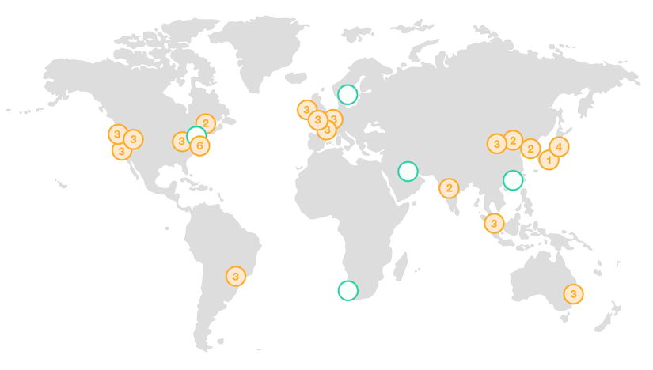
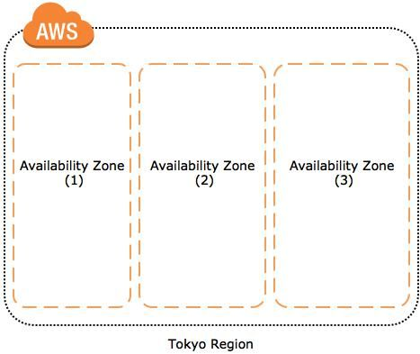
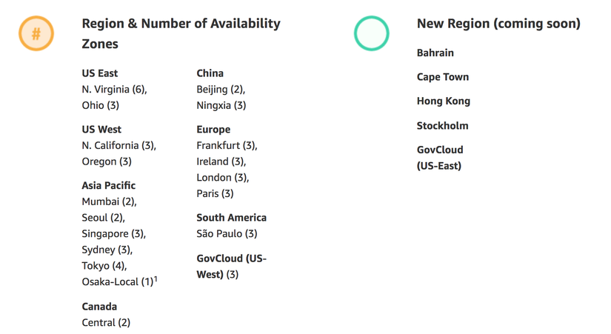
Some basic concepts
Region
AZ (Availibility Zone)

Slide 8
VPC Component

Slide 9
VPC components
VPC
Subnet
Internet Gateway
NAT Gateway
Peering Connection
VPC Endpoint
Egress-only Internet Gateway
Elastic IP Addresses
Security
Virtual Private Network (VPN)

Slide 10
VPC

Slide 11
VPC
A Virtual Private Cloud: is a virtual network dedicated to your AWS account. It is logically isolated from other virtual networks in the AWS Cloud. You can launch your AWS resources, such as Amazon EC2 instances, into your VPC. You can specify an IP address range for the VPC, add subnets, associate security groups, and configure route tables.
When you create a VPC, you must specify an IPv4 CIDR block for the VPC. The allowed block size is between a /16 netmask (65,536 IP addresses) and /28 netmask (16 IP addresses). After you've created your VPC, you can associate secondary CIDR blocks with the VPC.

Slide 12
Subnet

Slide 13
Subnet
Subnet: is a range of IP addresses in your VPC. You can launch AWS resources into a specified subnet. Use a public subnet for resources that must be connected to the internet, and a private subnet for resources that won't be connected to the internet.
The CIDR block of a subnet can be the same as the CIDR block for the VPC (for a single subnet in the VPC), or a subset of the CIDR block for the VPC (for multiple subnets)
Subnet Routing: each subnet must be associated with a route table, which specifies the allowed routes for outbound traffic leaving the subnet. Every subnet that you create is automatically associated with the main route table for the VPC.
Subnet Security: each subnet must be associated with a network ACL. Every subnet that you create is automatically associated with the VPC's default network ACL.

Slide 14

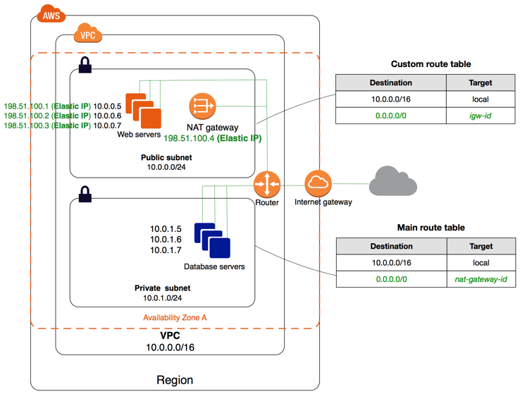
Public/Private Subnet

Slide 15
VPC subnet recommendations
/16 VPC (64K IPv4 addresses)
/24 subnets (251 IPv4 addresses)
One subnet per Availability Zone
For IPv6:
/56 Allocated per VPC (Lots of addresses)
/64 subnets (256 Subnets)

Slide 16
Internet Gateway

Slide 17
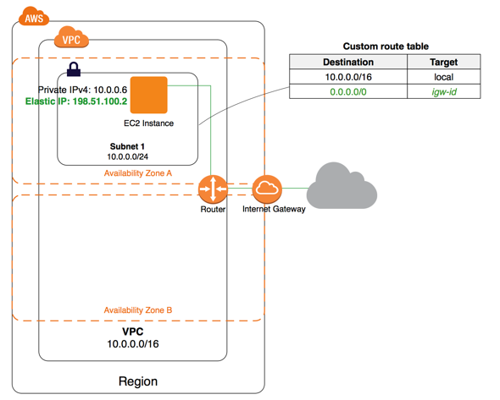
Internet Gateway
The Amazon VPC side of a connection to the public Internet.

Slide 18
NAT Gateway
Network address translation (NAT) gateway is used to enable instances in a private subnet to connect to the internet or other AWS services, but prevent the internet from initiating a connection with those instances

Slide 19
Peering Connection

Slide 20
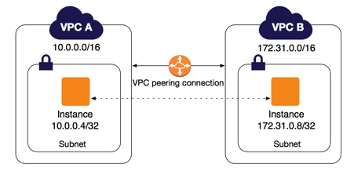
Peering Connection
A peering connection enables you to route traffic via private IP addresses between two peered VPCs.

Slide 21
VPC Endpoint

Slide 22
VPC Endpoint
Enables private connectivity to services hosted in AWS, from within your VPC without using an Internet Gateway, VPN, Network Address Translation (NAT) devices, or firewall proxies. Endpoints are virtual devices. There are two types of VPC endpoints: interface endpoints and gateway endpoints. Create the type of VPC endpoint required by the supported service.

Slide 23
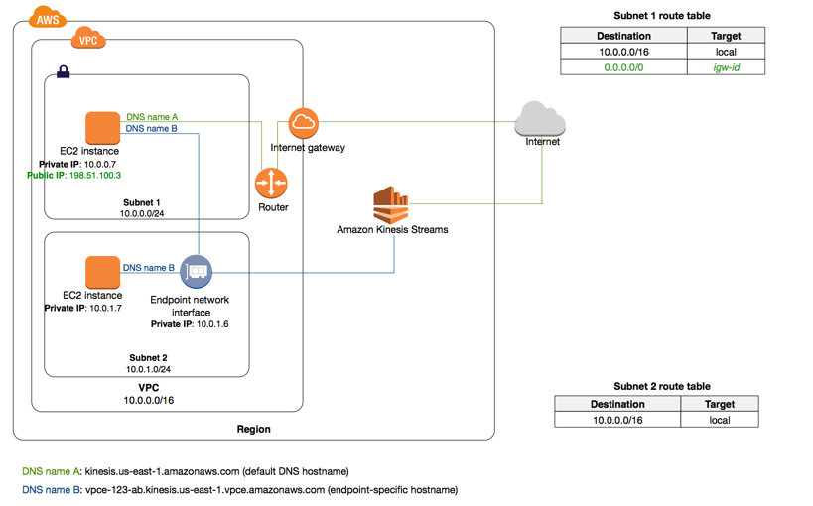
An interface endpoint is an elastic network interface with a private IP address that serves as an entry point for traffic destined to a supported service.

Slide 24
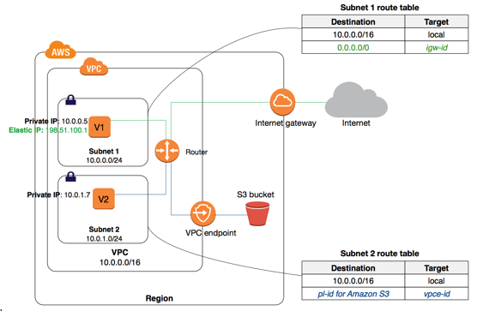
A gateway endpoint is a gateway that is a target for a specified route in your route table, used for traffic destined to a supported AWS service.

Slide 25
Egress-only Internet Gateway

Slide 26
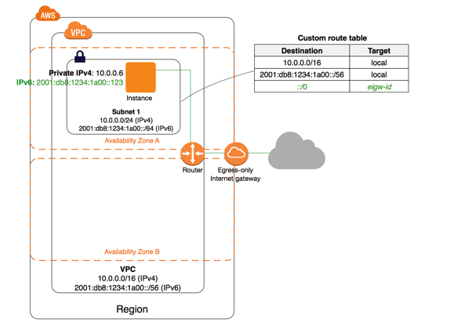
Egress-only Internet Gateway
A stateful gateway to provide egress only access for IPv6 traffic from the VPC to the Internet (that allows outbound communication over IPv6 from instances in your VPC to the Internet, and prevents the Internet from initiating an IPv6 connection with your instances.)

Slide 27
Elastic IP Addresses

Slide 28
Elastic IP Addresses
Elastic IP Addresses: is a static, public IPv4 address designed for dynamic cloud computing. You can associate an Elastic IP address with any instance or network interface for any VPC in your account. With an Elastic IP address, you can mask the failure of an instance by rapidly remapping the address to another instance in your VPC (the advantage of associating the Elastic IP address with the network interface instead of directly with the instance is that you can move all the attributes of the network interface from one instance to another in a single step)

Slide 29
Security

Slide 30
Security
AWS provides two features that you can use to increase security in your VPC: security groups and network ACLs.
Security groups control inbound and outbound traffic for your instances
Network ACLs is an optional layer of security for your VPC that acts as a firewall for controlling inbound and outbound traffic for your subnets (a optional layer of security for your VPC that acts as a firewall)

Slide 31
Virtual Private Network (VPN)

Slide 32
VPN
Create Customer Gateway: Specify the Internet-routable IP address for your gateway's external interface.
Virtual private gateway: The Amazon VPC side of a VPN connection.
Site-to-site VPN Connections: Mapping the virtual private gateway and customer gateway that you would like to connect via a VPN connection.

Slide 33
VPC and Subnets relationship

Slide 34
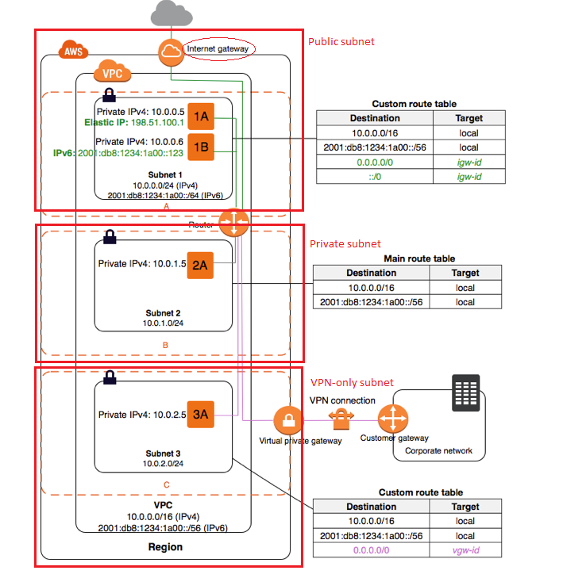
VPC and Subnets relationship
VPC 1<----->n subnets
Each subnet must reside entirely within one Availability Zone and cannot span zones
Availability Zones are distinct locations that are engineered to be isolated from failures in other Availability Zones

Slide 35
VPC and Subnets relationship
A VPC or subnet must have IPv4 CIDR bock and optional IPv6 CIDR blockEach subnet must reside entirely within one Availability Zone and cannot span zones
The CIDR block of a subnet can be the same as the CIDR block for the VPC (in case Single public subnet) and cannot overlap in multiple subnets case
The first four IP addresses and the last IP address in each subnet CIDR block are not available for instances:
First address: Network address
Second address: Reserved by AWS for the VPC router
Third address: IP address of the DNS server
Fourth address: Reserved by AWS for future use
Last address: Network broadcast address

Slide 36
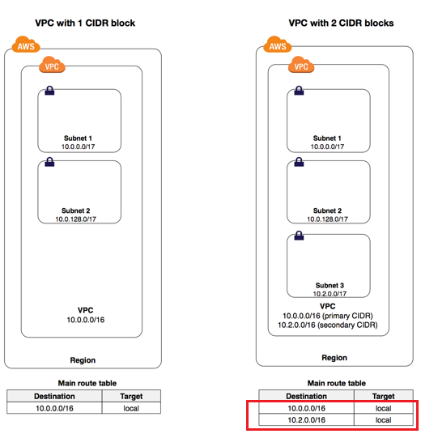
VPC and Subnets relationship
We can create a VPC with a publicly routable CIDR block that falls outside of the private IPv4 address ranges specified in RFC 1918
Multiple CIDR blocks in a VPC
We have two network address at here?
Rules to add IPv4 CIDR blocks into VPC
Rules to add IPv6 CIDR blocks into VPC
Subnet Routing
Subnet Security: security groups and network ACLs
Security groups control inbound and outbound traffic for your instances
Network ACLs control inbound and outbound traffic for your subnets

Slide 37

Scenarios and Examples

Slide 38
Scenarios and Examples
Scenario 1: VPC with a Single Public Subnet
Scenario 2: VPC with Public and Private Subnets (NAT)
Scenario 3: VPC with Public and Private Subnets and AWS Site-to-Site VPN Access
Scenario 4: VPC with a Private Subnet Only and AWS Site-to-Site VPN Access

Slide 39
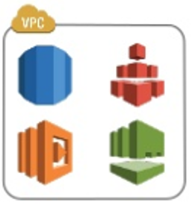
Place your screenshot here
Best practice for in VPC-AWS services.
Many AWS services support running in –VPC.
Use security groups for Least-Privilege network access.
For best avaibility, use multiple Avaibility Zones.
Ex:
Multi-zone RDS deployments
Use a zonal mount point for EFS access

Slide 40
THANKS!
Any questions?
Connect to github repository to read more detail: https://github.com/hueanmy/AWS-LEARNING

